Slide 1
DayCare
Presented by
Jiawei Qian
Chunzheng Wen
Jiao He
Fangyu Wu
Siyan Li
Zifeng Xu
Yi-Chen Yi
Ching-Fong Chen

Slide 2
Introduction
The application aims to cope with the children day care issues .
Features:
Add, delete and view student information; track annual student registration renewal .
View teacher detailed information and track annual employee review .
Assign student/teacher groups to classrooms according to age.
Assign student to teachers .
Track student immunization record .

Slide 3
Operation Instructions
IDE
Technology and Patterns
Apache NetBeans 12.5
Db4o Database
MVC Design Pattern
Factory Design Pattern
Swing UI
JDK
JDK1.8

Slide 4
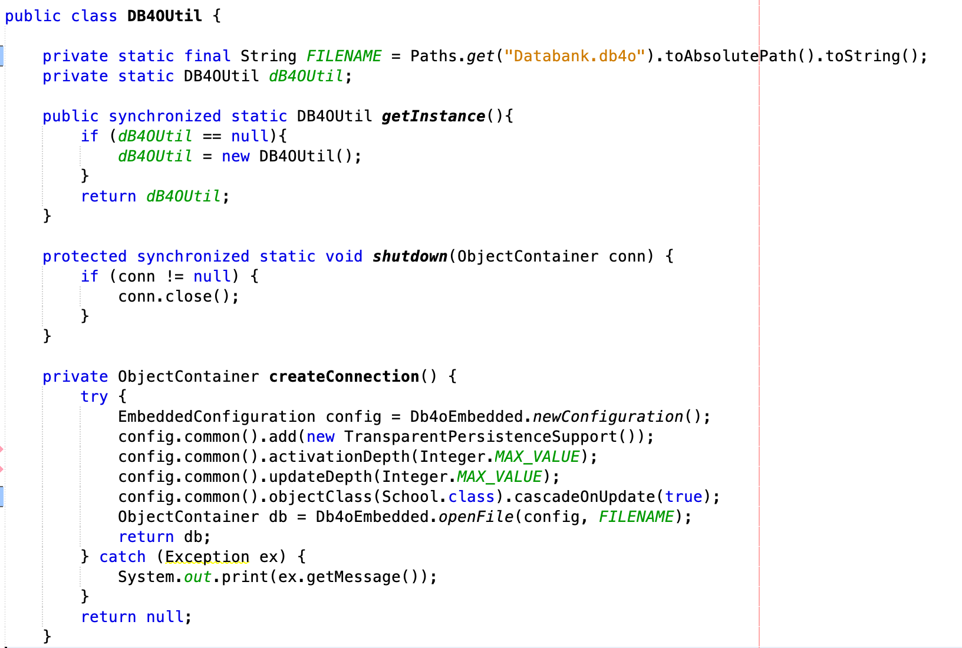
db4o Database
db4o is an embeddable open-source object database for Java developers.

Slide 5
Design Pattern

Slide 6
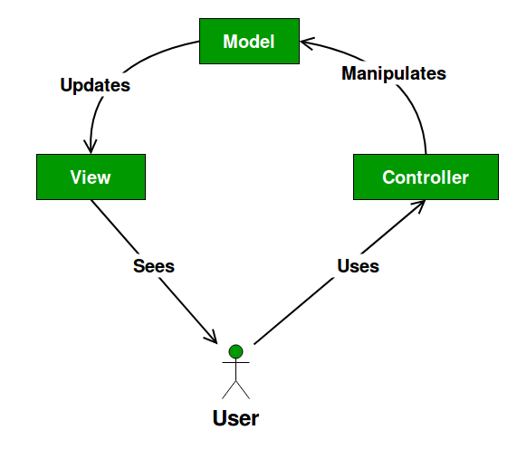
Model View Controller Pattern
The MVC design pattern specifies that an application consist of a data model, presentation information, and control information.

Slide 7
MVC
Model
Controller
View
Only manipulate application data, no presenting the data to a user.
The Controller exists between the view and the model. It listens to events triggered by the view and executes the reactions to these events.
The View layer presents the data to users. It shows data processed by model layer.

Slide 8
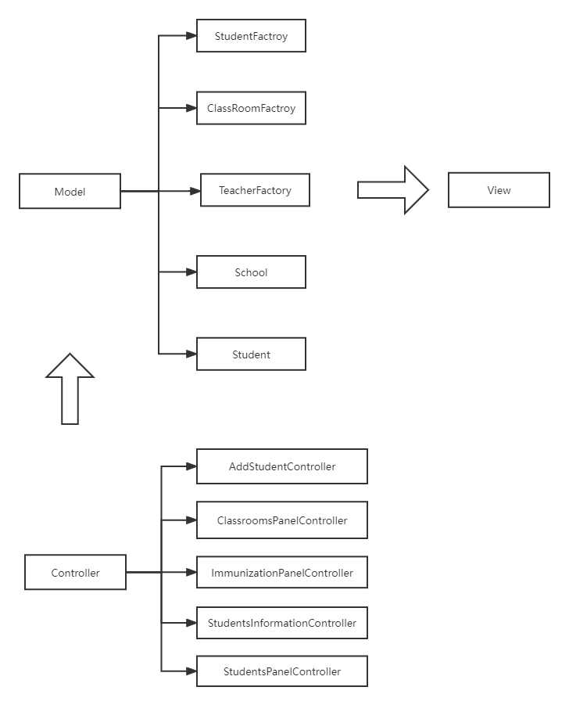
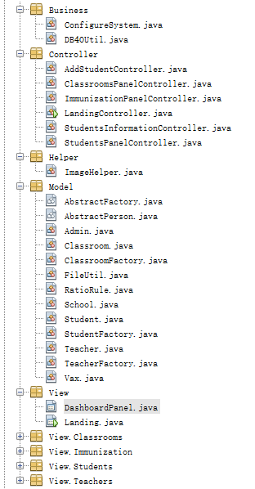
Implementation

Slide 9
The factory design pattern says that define an interface (A java interface or an abstract class)and let the subclasses decide which object to instantiate.
Factory Design Pattern

Slide 10
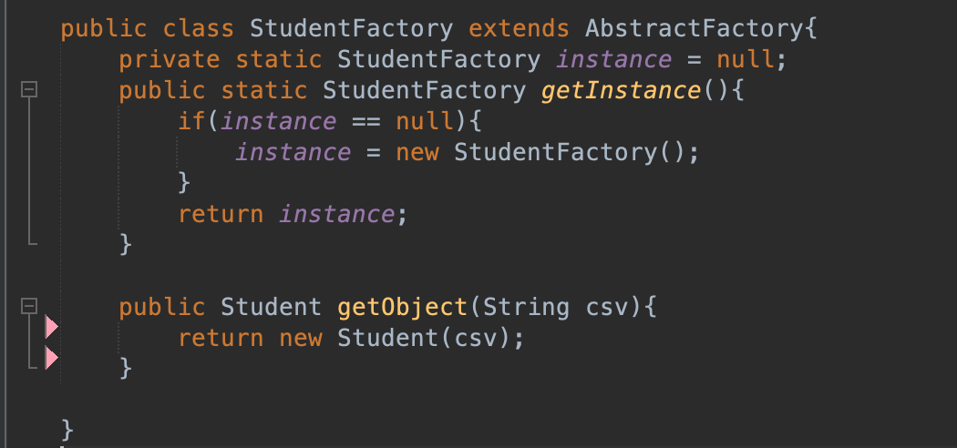
Implementation
1.We use a StudentFactory class and define the getObject method to generate Student Object.
2.The factory class obeys the lazy Singleton design pattern. When the application runs, the factory will be created when it needs to be used.

Slide 11
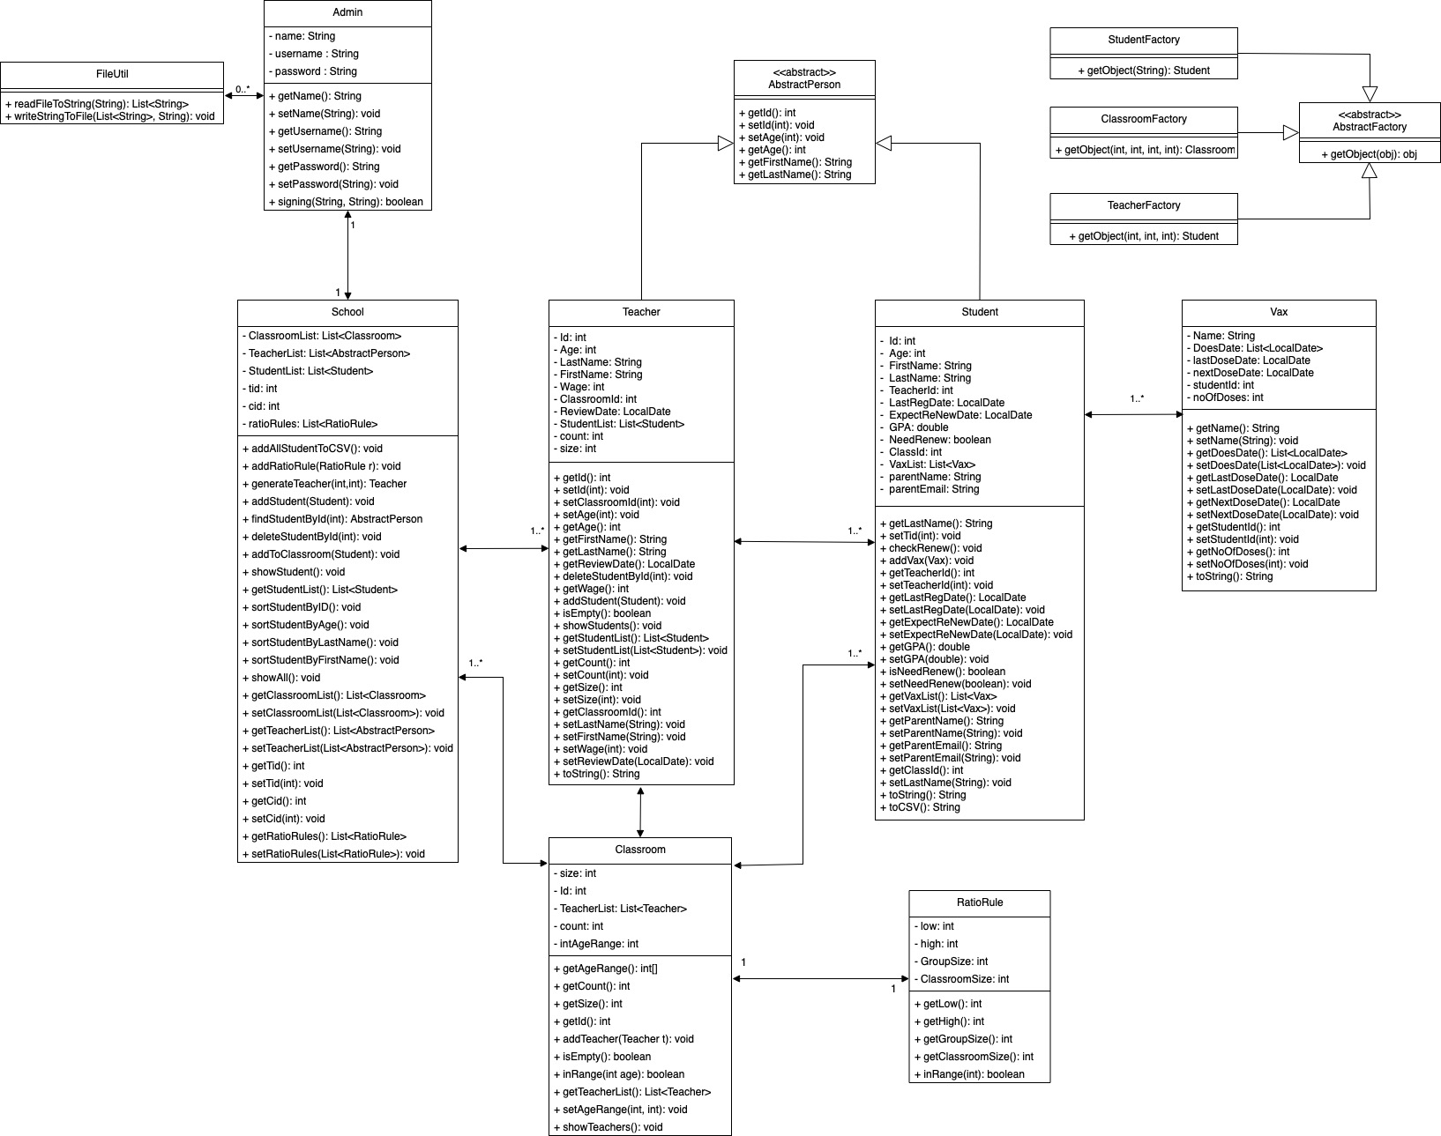
UML
Diagram

Slide 12
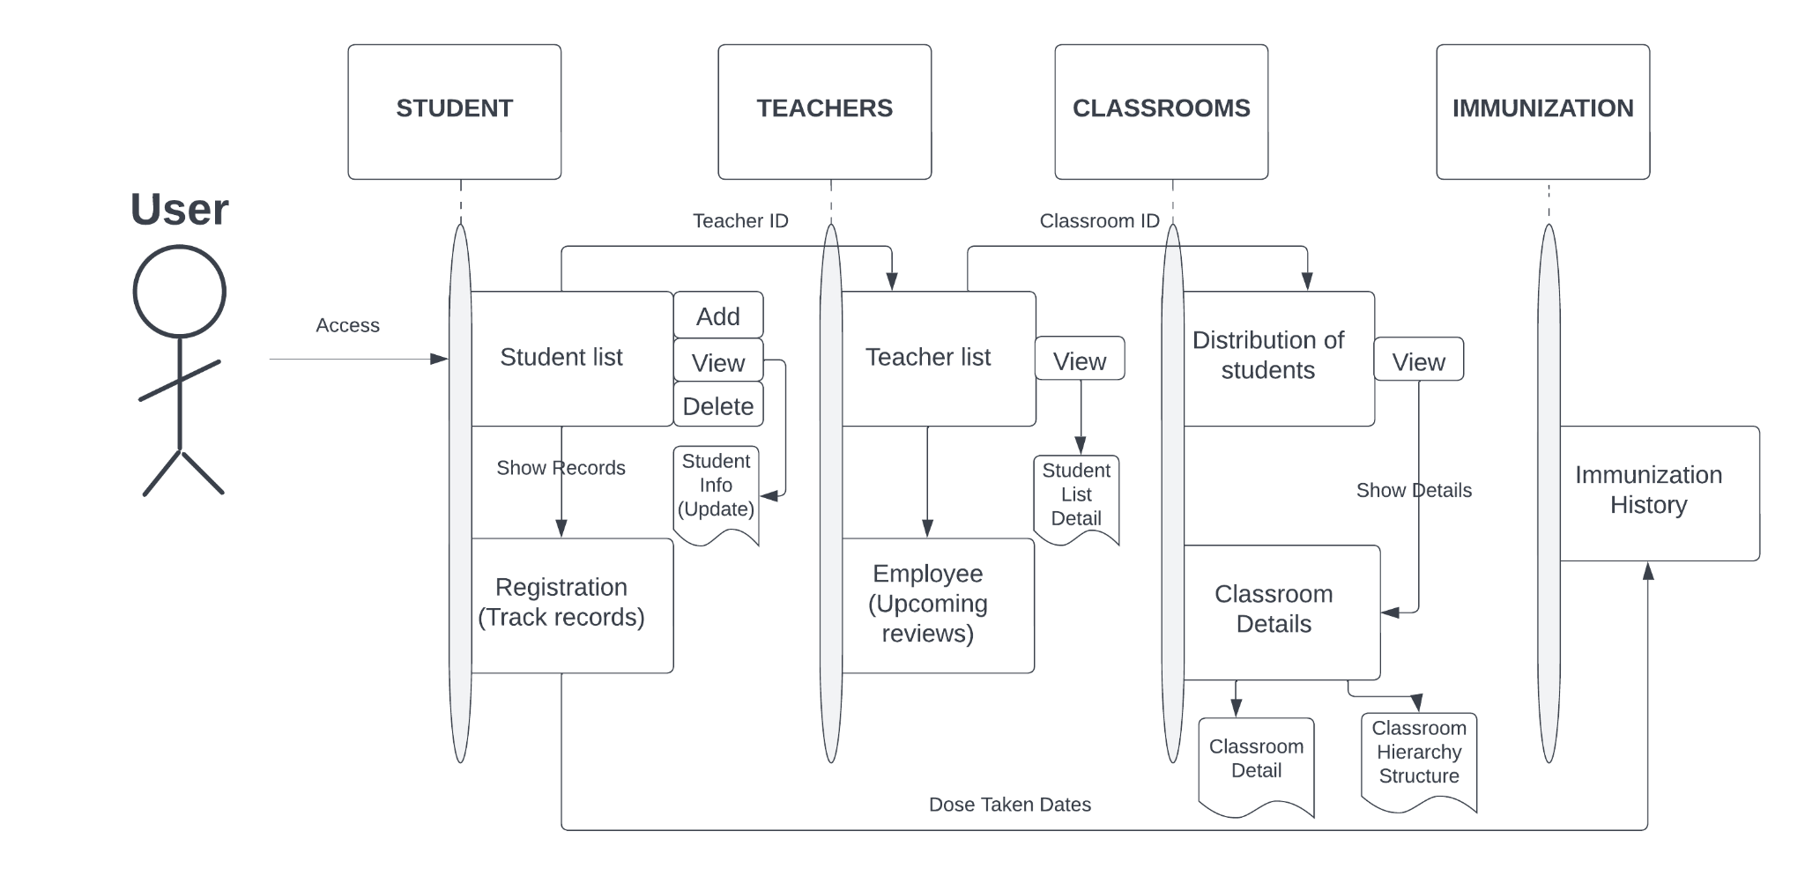
Sequential Diagram
CEO

Slide 13
Member Contributions
Jiawei Qian & Chunzheng Wen
Add, update and view students student information panel
Siyan Li & Zifeng Xu
Assign students and teachers into classrooms, and classroom panel
Jiao He & Fangyu Wu
Generate teacher information, teacher review and teacher panel
Ching-Fong Chen & Yi-Chen Yi
Record Immunization for students and vaccination panel

Slide 14
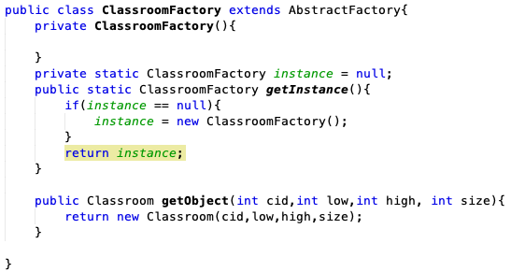
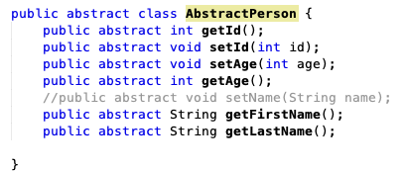
Knowledge
Applied
1. Used Objects Oriented Design into
Applications.
2. Improved implementation by SOLID design,
and applied Simple Factory design pattern.
3. Collaborated with Java Swing and GUI
components under NetBeans.
4. Used a few simple data structures like List,
Map

Slide 15
Future
Enhancement
1. We may use a relational database like mysql or sql
server in the future. As relational databases can
better describe the relationships between different
objects.
2. We may add multithreading functions to our
application as it could effectively improve multi-user
access performance.
3. We may use some extra design patterns to our
application like Prototype, Adapter, and Observer
Pattern.
4. We could use some frame like SpringBoot to upgrade our
application to an advanced web project which could be
accessed via browser.

Slide 16
Thank you for your time!

